Slide 1
Famous faces homeroom competition
NAIDOC WEEK 2021

Slide 2
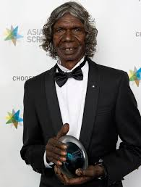
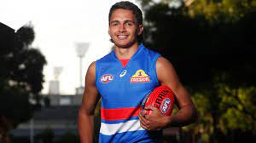
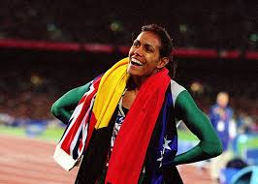
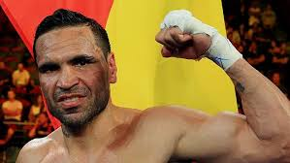
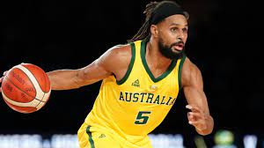
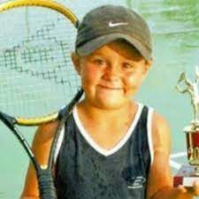
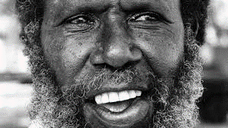
1
2
3
4
5
6
7
8
9

Slide 3
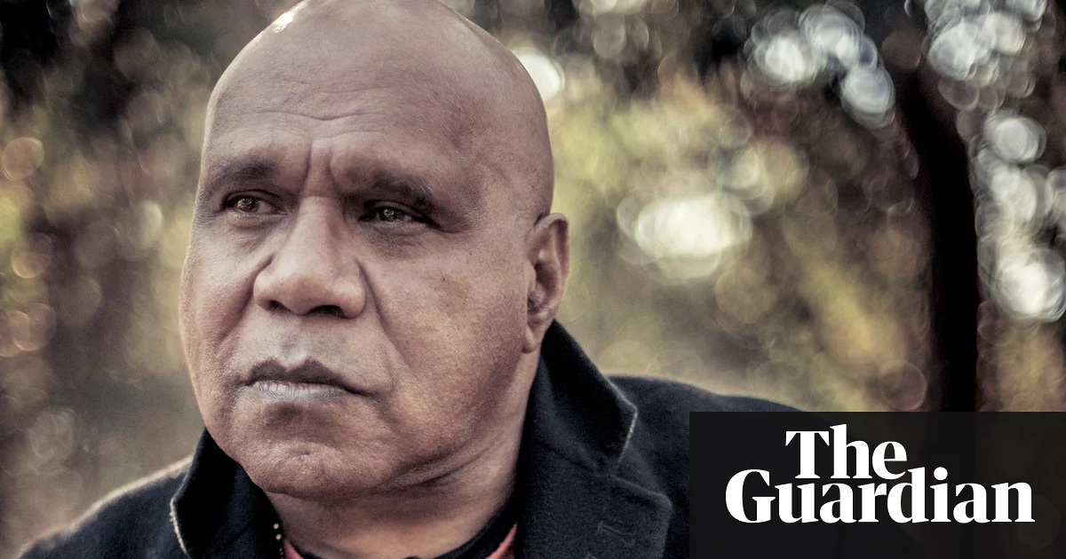
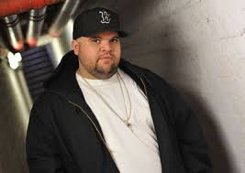
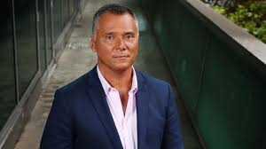
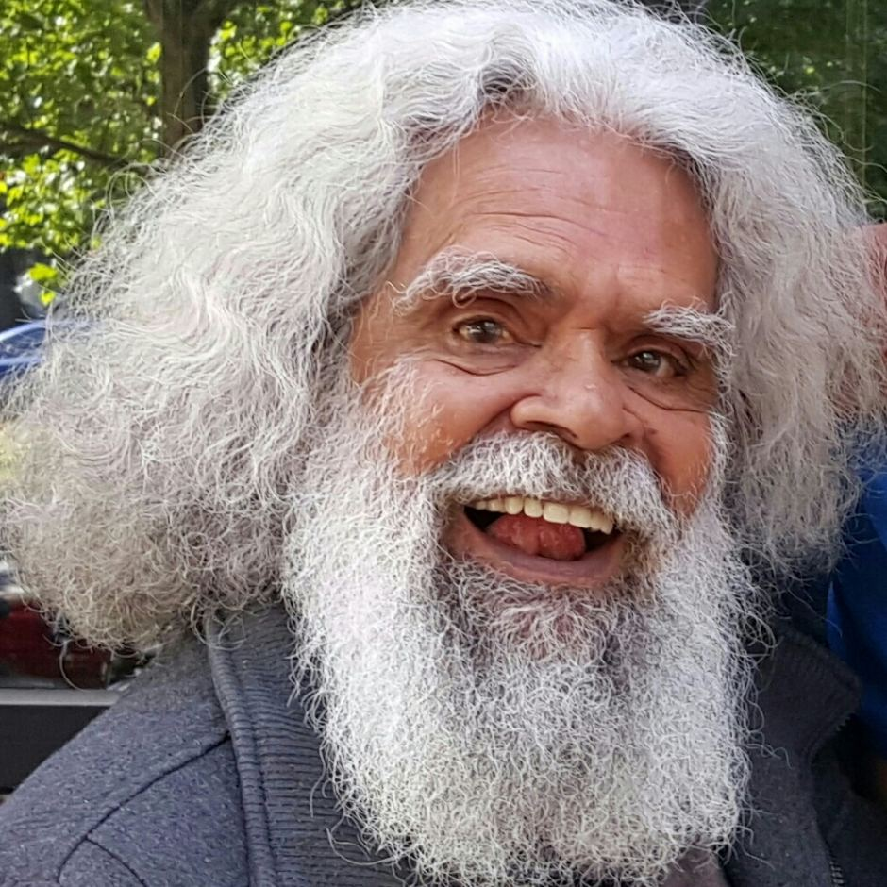
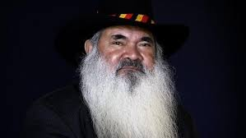
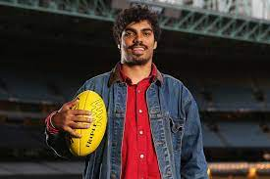
10
11
12
13
14
15

Slide 4
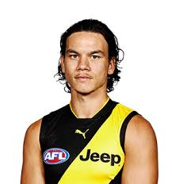
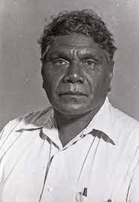
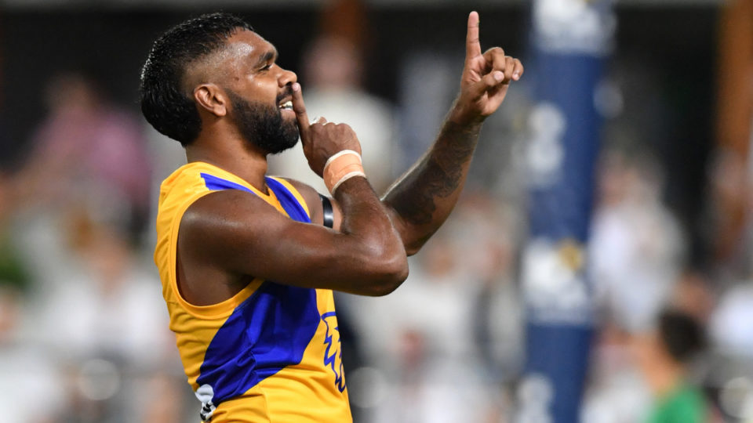
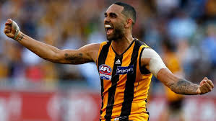
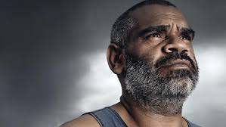
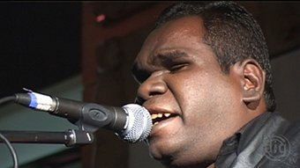
16
17
18
21
20
19

Slide 5
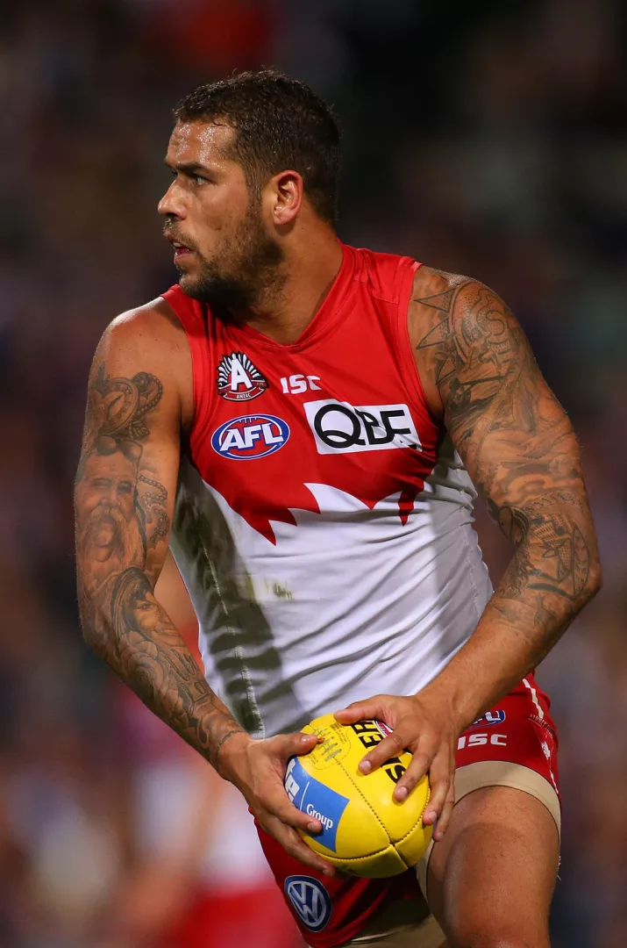
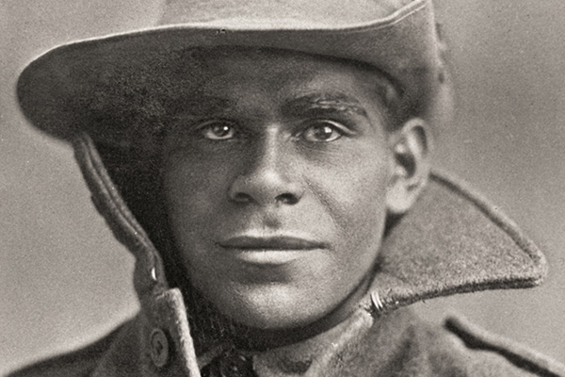
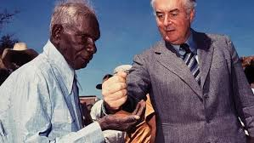
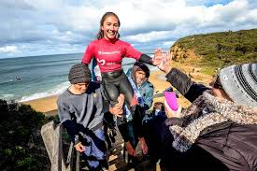
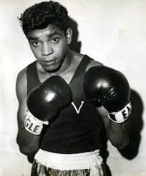
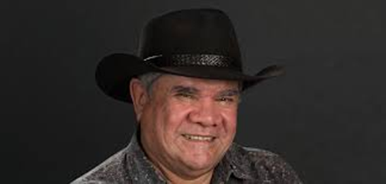
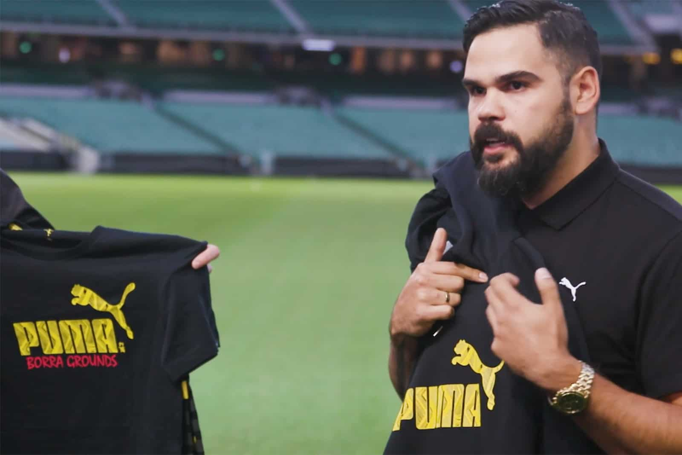
23
24
22
28
26
27
25

Slide 6
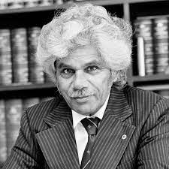
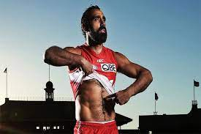
29
30

Slide 7
Answers
Jamarra Ugle-Hagan
Cathy Freeman
David Gulpuilil
Anthony Mundine
Patty Mills
Ash Barty
Jessica Mauboy
Eddie Mabo
Samantha Harris
10. Archie Roach
11. Adam Briggs
12. Stan Grant
13. Jack Charles
14. Pat Dodson
15. Tony Armstrong
16. Daniel Rioli
17. Albert Namatjira

Slide 8
Answers
18. Liam Ryan
19. Shaun Burgoyne
20. Michael Long
21. Geoffrey Gurrumul Yunupingu
22. Private Miller Mack
23. Vincent Lingiari
24. Lance Franklin
25. Robert Young
26. Mick Dobson (lawyer)
27. Summer Simon
28. Lionel Rose
29. Neville Bonner
30. Adam Goodes

